Slide 1


Sprint 1 Delivery
Group 2 | RB-03

Slide 2


Table of Contents
Activities
Use Cases
Research:
Can Appsemble be sufficiently performant?
Can Appsemble be connected to a service bus?
Are there any alternatives to Appsemble?
How can messaging be done in an enterprise system?
Recommendation
What’s Next?

Slide 3

Activities
Functional & Non-functional Requirements
Use Cases
Use Case Diagram
Research Plan
Research Report

Slide 4

Use Cases
Make a reservation
Cancel a reservation
Configure timeslots
Configure restaurant capacity
Manager cancels a reservation

Slide 5

Research

Slide 6
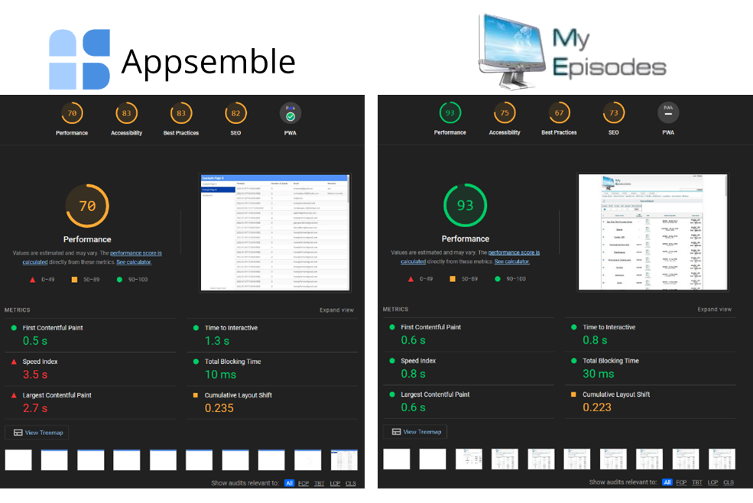


Can Appsemble be sufficiently performant?
Testing load times
Google Lighthouse report
Compare with a similar web page
One hundred records
Possible use for Appsemble (as front-end)

Slide 7

Can Appsemble be connected to a service bus?
Current situation
Available alternatives
Expand source-code
Use a polling service
Connect to a custom back-end
Conclusion

Slide 8
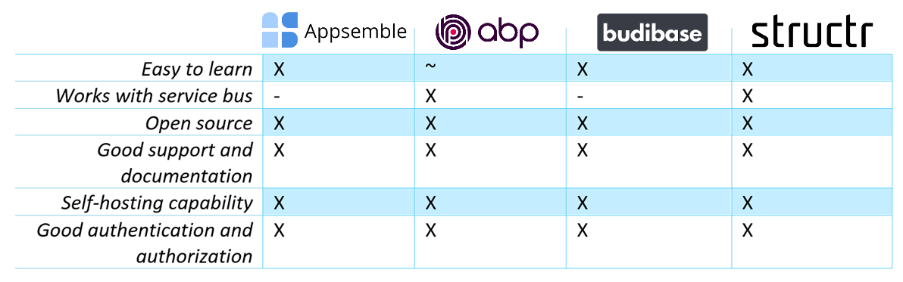



Are there any alternatives to Appsemble?
Low-code alternatives
ABP
Budibase
Structr
Comparison table
Conclusion

Slide 9



How can messaging be done securely in an enterprise system?
Use end-to-end encryption
Encrypt communications secrets
Keep your dependencies up to date
Use authentication and authorization
Automate the tests in your system
Implement rate limits

Slide 10






Recommendation
Move away from no-code
Flexibility
Scalability
Performance

Slide 11

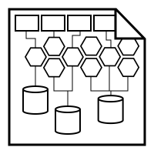


What’s Next?
Architecture research
GDPR research
Design
Prototype

Slide 12

Thanks for listening!

